Slide 1
Virtual Portfolio(rev0)
By Zachary king

Slide 2
What Is my project?
ResumeSkillsWebsite
To act as a digital portfolio for my CS skills.
Background:
Webstore project

Slide 3
Why I chose this project?
I chose this because I wanted to do something that would benefit me in the long-run.
Prior knowledge:
Language: HTML, CSS, Javascript, Java, Python
IDE: VSCode
Topic: My past projects.

Slide 4
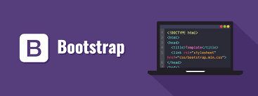

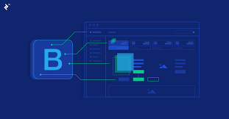
How I developed this project
Programs:
Visual Studio Code
Ideone.com
OnlineGDB.com
Learned:
Bootstrap
Iframe section of HTML
More HTML, CSS, Javascript

Slide 5
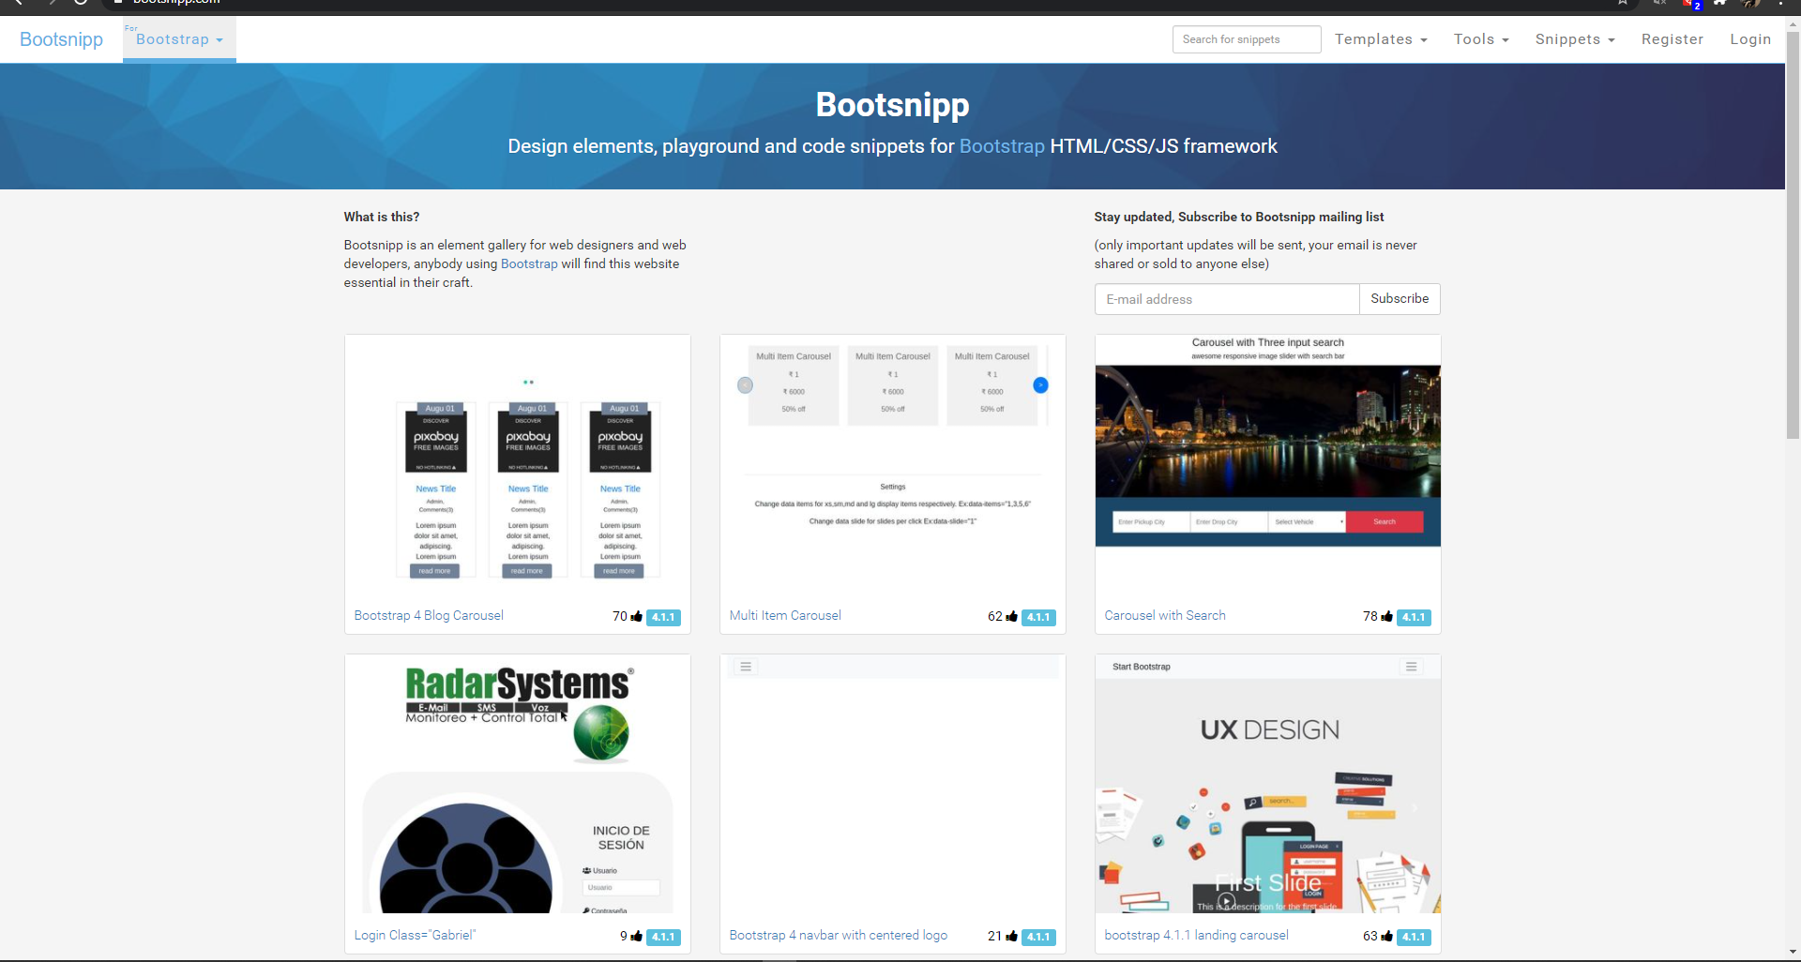
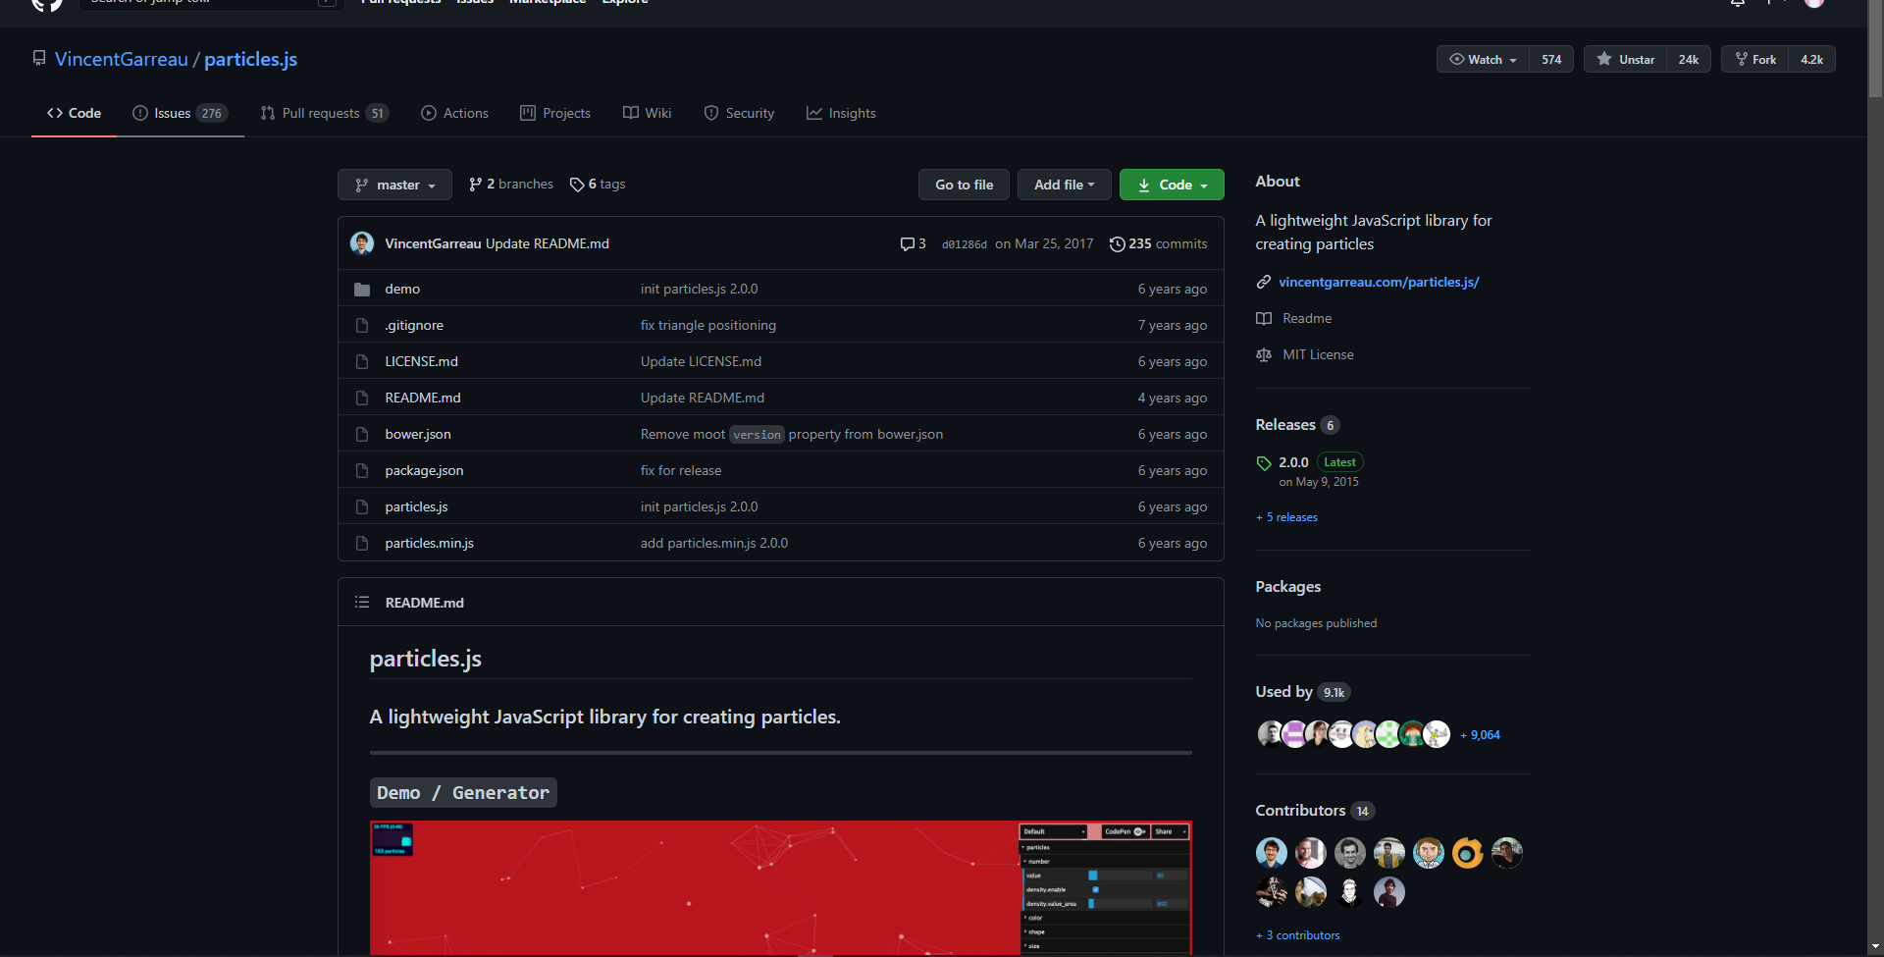
Who helped me with this project?
Major outside Sources:
Bootsnipp.com
Vincent Garreau (particles.js)
Most Helpful:
Particles.js
40% - 60% of code is “inspired” by other programs.

Slide 6
When did you develop it?
Research: 10 – 12 hours
Moving background: 12 hours
Errors & formatting issues from background: 16 hours
Code Showcase Screens: 4 – 6 hours
About Screen & Additional features: 3 hours
Additional Formatting & Debugging: 2 – 6 hours

Slide 7
When did you develop it?
Left out:
Animations
A lot of the additional style & formatting
Coding landing page screen
Section(s) that took longer than expected:
Moving background
Section(s) that took less time than expected:
Code showcase screen

Slide 8
Development Process
What features came first?
Background & navbar
Which feature was the hardest to develop?
Moving background.
Which feature taught you the most?
Moving background

Slide 9
Development Process
Which feature do you want to add?
Moving Background
When did you give up?
After attempting to fix all the formatting error from the moving background.
When did you get some motivation?
After I started adding the retro gifs. (gave me improvement ideas)

Slide 10
Future of my website
Website will always be changing because it is my CS portfolio.
This project has actually made me excited about coding again. However, I’m still not sure what I want to do.
If I could start over, I would forget about that moving particle background.

Slide 11
Next Steps for my project (General)
COMPETELY overhaul the formatting, animations, & theme of the website.
Custom code runner window.
Where/what to host on?
Optimization.
Continue improving

Slide 12
Next Steps (Part 1): Background
Example:
Banner Section:
First Section:
Retro pixel-art style city for the background:
The farther you scroll down, the further you go into the depths of the city.
Each section is its own gif.
Similar to the idea of the levels of the city of Coruscant in Star Wars
Second Section:
Third Section:
Fourth Section:
Fifth Section:
Footer:

Slide 13
Next Steps (Part 1): Navbar
Add neon highlights
Configure to patch desired format, style, & theme
Color gradients

Slide 14
Next steps (part 1): Animations
Add animation to any logical (and tasteful) item.
As long as it enhances the website’s appearance, not hinders it.

Slide 15
Next Steps (Part 2): Code Runner window
Custom inner windows on my site, allowing me to preload code onto them that showcase some of my CS projects.
Match the theme, formatting, & style
Disables editing (for security reasons)
responsive

Slide 16
Next Steps (Part 3): website host
How to host the website?
Anything from Raspberry Pi – GitLabs & Jekyll
Need to get further to decide which.

Slide 17
Next Steps (part 4): Optimization
Reduce windows load time
(If possible) Place repeated, or “non-essential”, code into separate files to be called as functions.
Lossless compression for gifs & Images.

Slide 18
Next Steps (part 5): Continue Improving
Once next step objectives 1-4 are complete, go through again and find things to improve. Repeat until done.

Slide 19
Advice
Advice for next year’s Seniors Independent Projects:
Start small and add on after you’re done.

